Slide 1
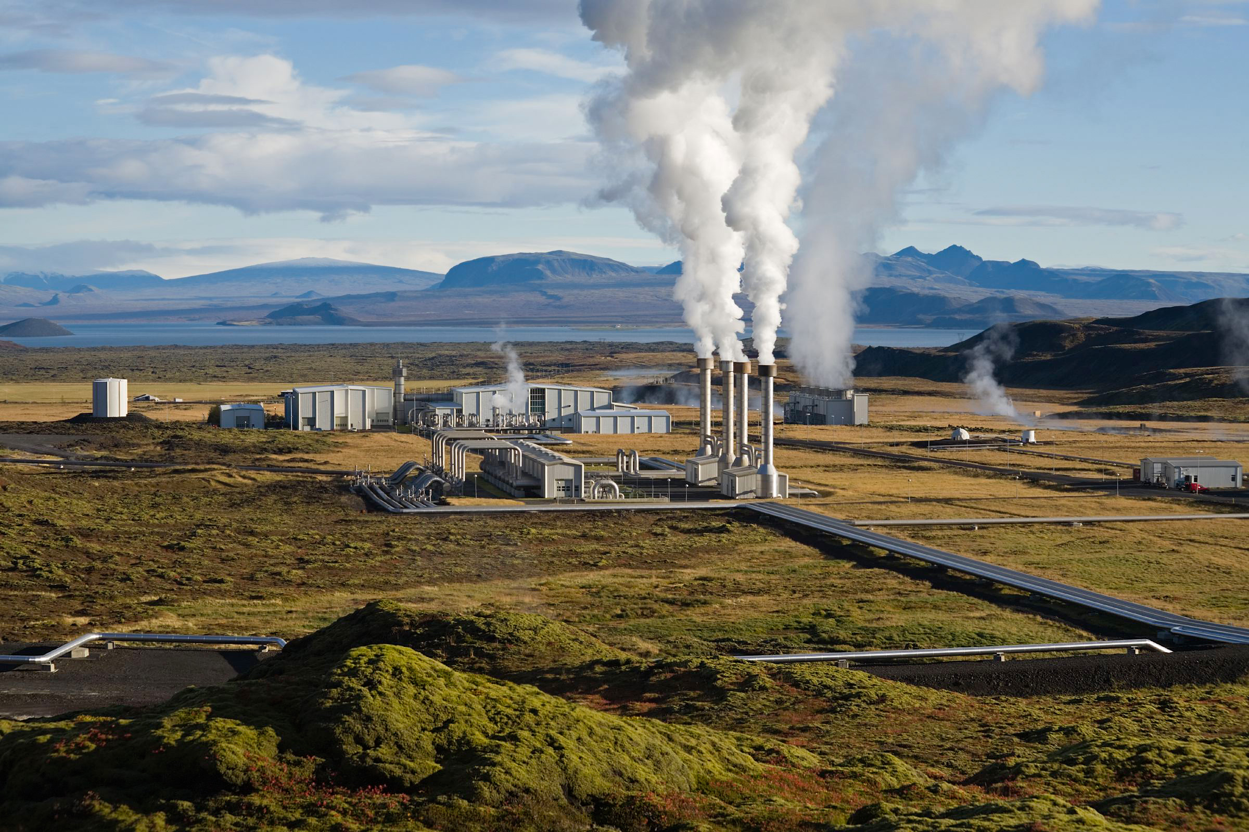
Shallow Geothermal Energy Development
By Ifeanyi Francis Izuegbunam (M12435237)
Clément Delattre (M12529478)
https://github.com/Ifefr-codes/shallow-geothermal-energy

Slide 2
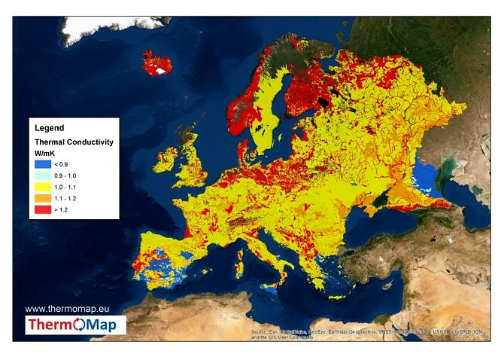
Introduction

Slide 3
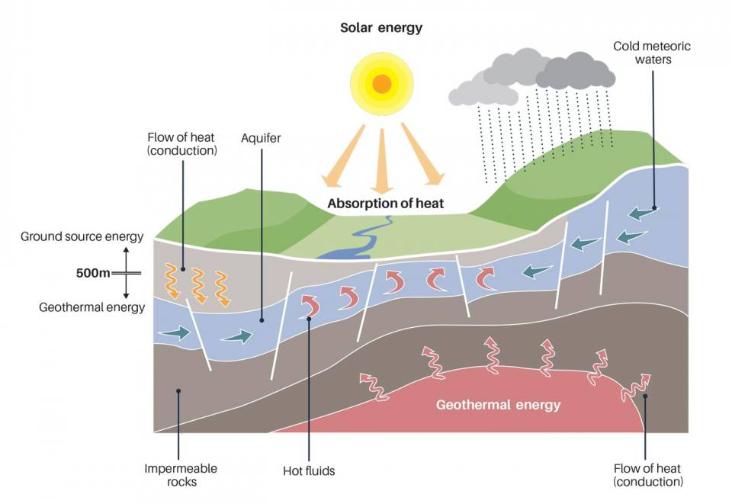
Introduction

Slide 4
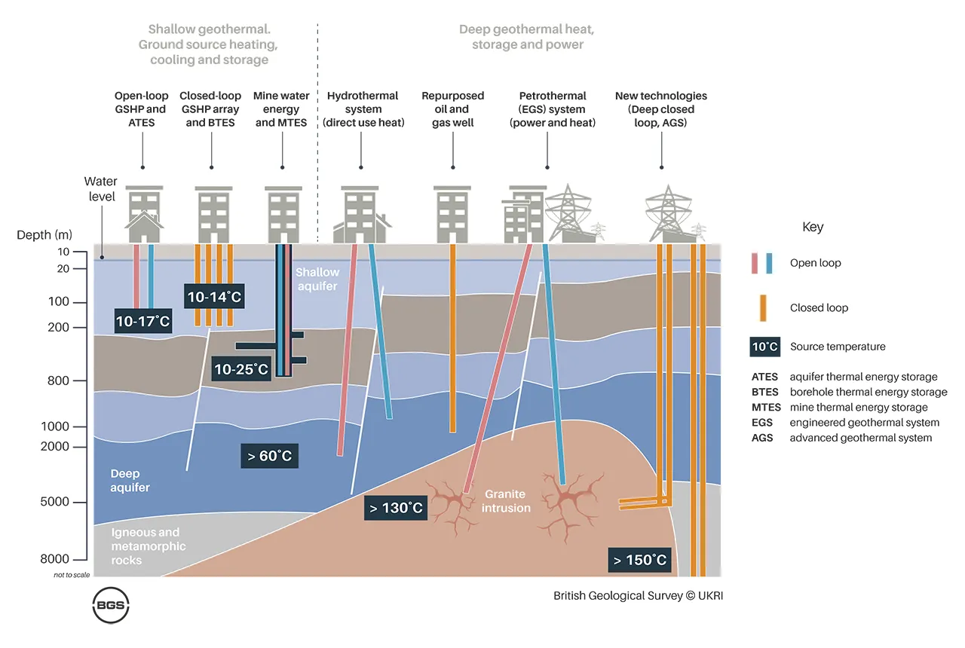
Types of geothermal system

Slide 5
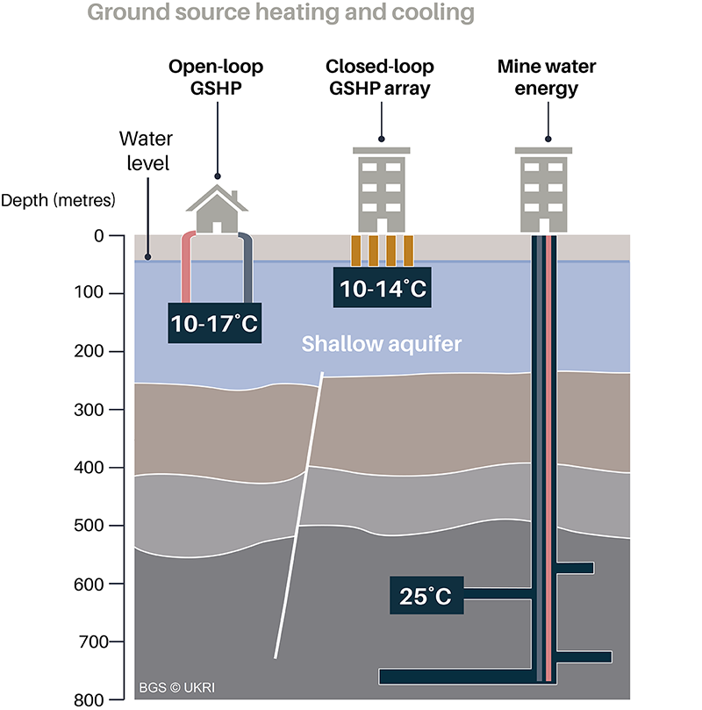
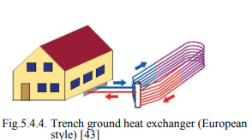
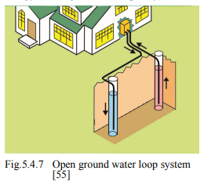
Very low temperature systems

Slide 6
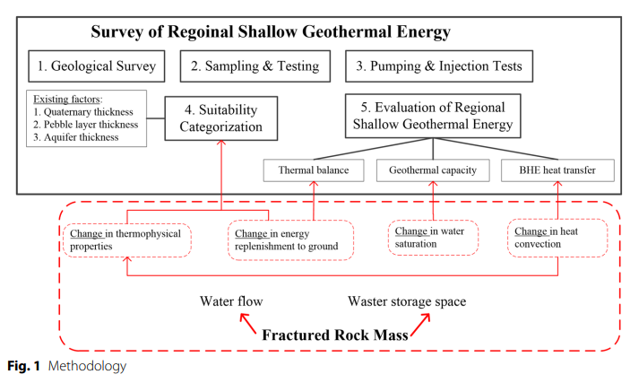
Geological context and petrophysical properties

Slide 7
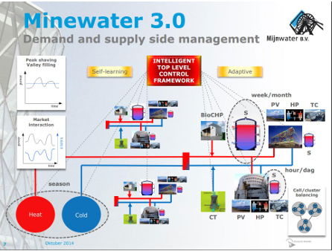
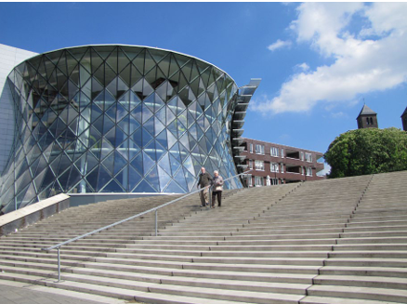
Advantages, drawbacks, and prospects: Case 1
Mijnwater, Heerlen (NL) – Project start 2008
Merits: Uses local renewable resource, low running emissions, first mover 5GDHC example and strong EU/EIB support for scaling
Hurdles: Yields variability/decline; need for building retrofits for low temperature supply; operational maintenance; permitting and stakeholder coordination
Prospectives: phased expansion plus monitoring, building retrofit/incentive programs, robust water management, blended financing and replication via EU projects

Slide 8
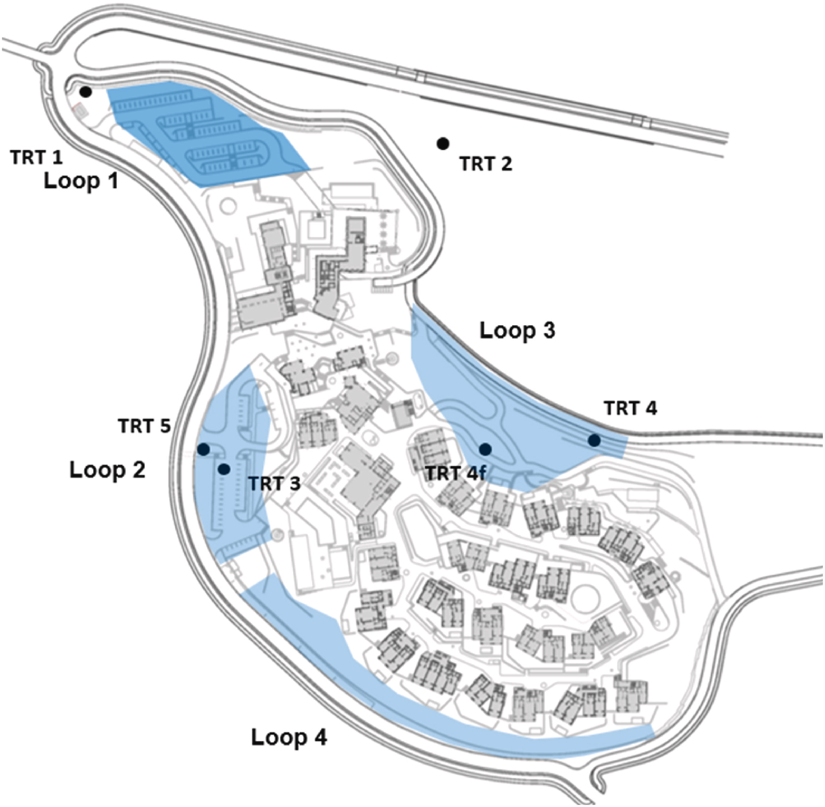
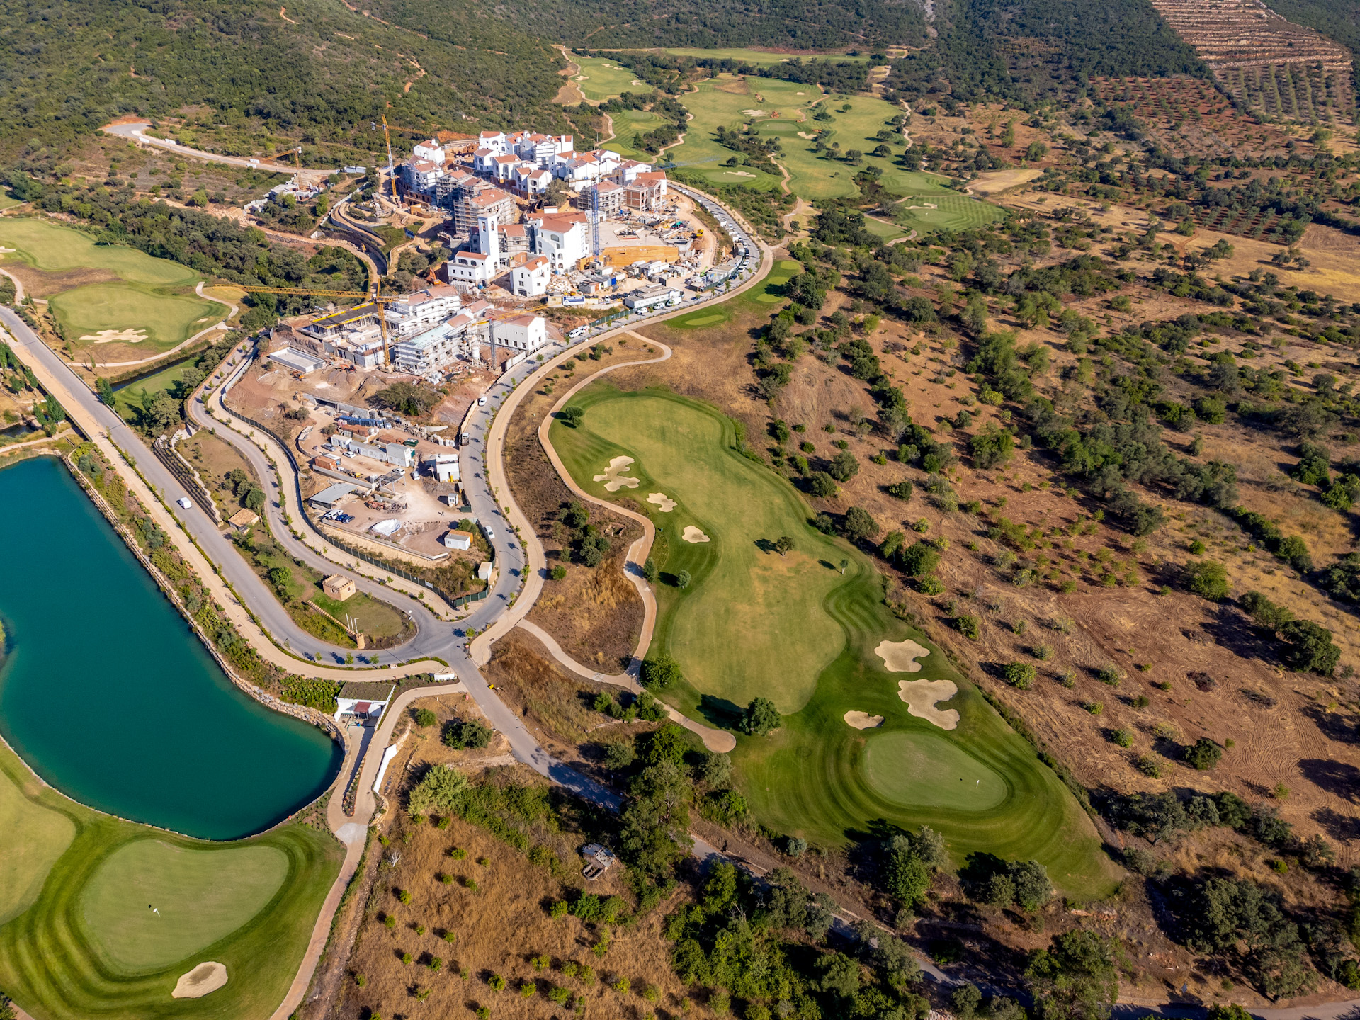
Advantages, drawbacks, and prospects: Case 2
Geothermal Energy at Ombria Resort (PL) - A Sustainable Path for Luxury Eco-Tourism
Merits: Aligns with sustainable brand, cutting carbon footprint, reduces long-term energy costs, and boosts guest comfort
Hurdles: High upfront investment, installation cost, and complex local geology requires specialized expertise due to Algarve’s karstic limestone
Prospectives: Implementation via modular phased rollout, accessing green grants and EU funding programs

Slide 9
Other notable global projects:
Shallow Geothermal System in Elizabeth Blackburn School of Sciences
Richard Stockton College (USA)
The Sphinx Observatory (Switzerland)
Reykjavik’s Geothermal Wells (Iceland)
Beijing Daxing Airport (China)
Messe Graz Congress Center (Austria)

Slide 10
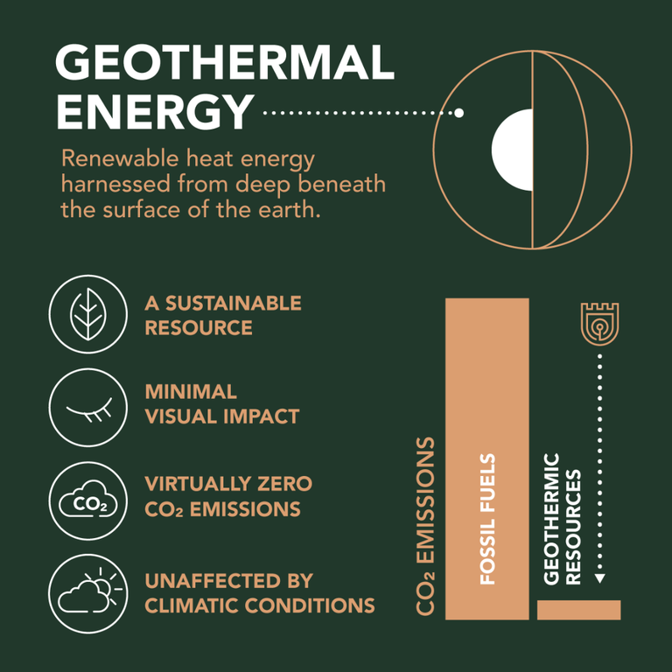
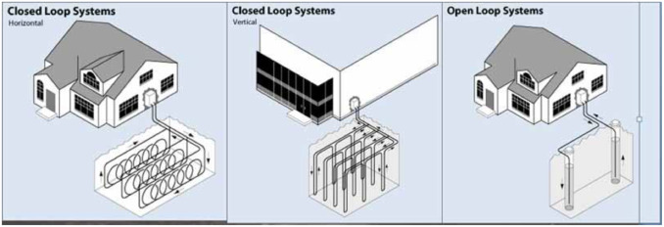
Conclusion
UNLOCK SHALLOW GEOTHERMAL’S POTENTIAL FOR WIDESPREAD, CLEAN HEATING AND COOLING
Project we have: A Python script that demonstrates shallow geothermal energy concepts and calculations

Slide 11


Videos on some great projects:
Notes:
https://youtu.be/GUy5o_-uMEk?list=TLGGiB4Qt10je6wxOTExMjAyNQ https://www.ombria.com/en/about/sustainability/geothermal-energy/ https://youtu.be/Plc0GmWmUPQ?si=-RIBNI6igFlU6WOF Shallow Geothermal System in Elizabeth Blackburn School of Sciences

Slide 12
Resources
Websites :
https://eurogeologists.eu/esteban-shallow-geothermal-energy-geological-energy-for-the-ecological-transition-and-its-inclusion-in-european-and-national-energy-policies/
https://geocom.geonardo.com/assets/elearning/6.22.Shallow%20Geothermal%20SYstems.pdf
https://causewaygt.com/2023/02/geothermal-system-archetypes-classification-applications-and-technology-development-opportunities/
https://www.eurelectric.org/in-detail/what-is-geothermal-power/
https://nfp-energie.ch/fr/dossiers/192/cards/381
https://www.euroheat.org/dhc/knowledge-hub/mijnwater-project-in-heerlen-the-netherlands
https://www.ombria.com/en/about/sustainability/geothermal-energy/
Reviews :
Ahmed, A.A., Assadi, M., Kalantar, A., Sliwa, T., Sapińska-Śliwa, A., 2022. A Critical Review on the Use of Shallow Geothermal Energy Systems for Heating and Cooling Purposes. Energies 15, 4281. https://doi.org/10.3390/en15124281
Deng, F., Pei, P., Ren, Y., Luo, T., Chen, Y., 2023. Investigation and evaluation methods of shallow geothermal energy considering the influences of fracture water flow. Geotherm Energy 11, 25. https://doi.org/10.1186/s40517-023-00267-1

